Slide 1




The book is in the stormy time in the idea of sailing ships,
which carefully the precious cargo to generation after generation.
02
Library Service

Slide 2

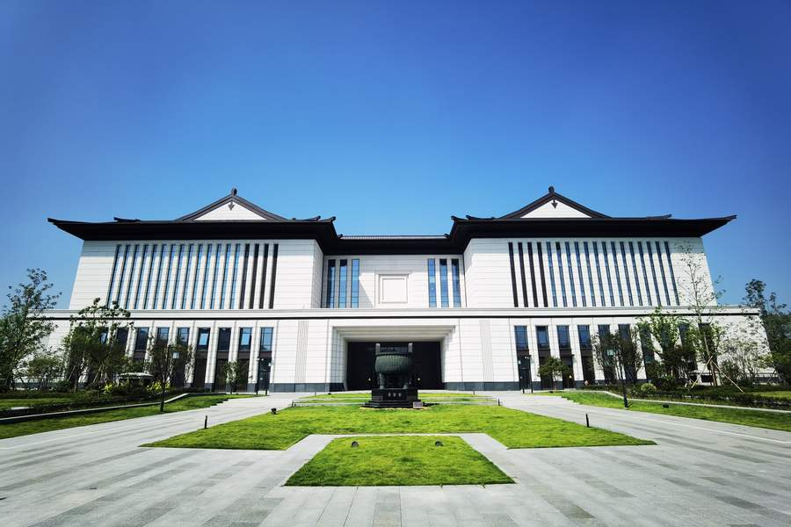


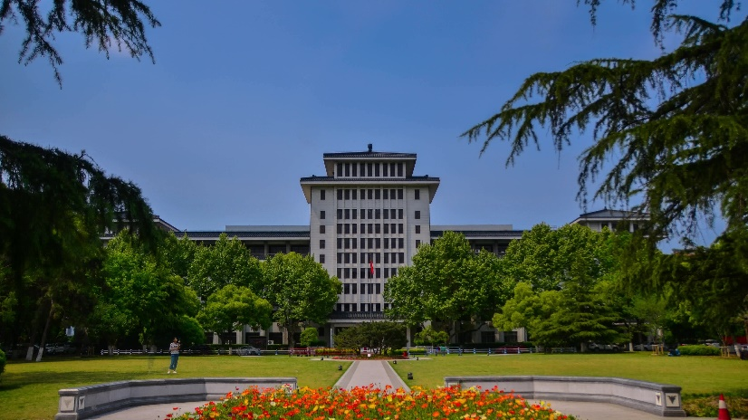
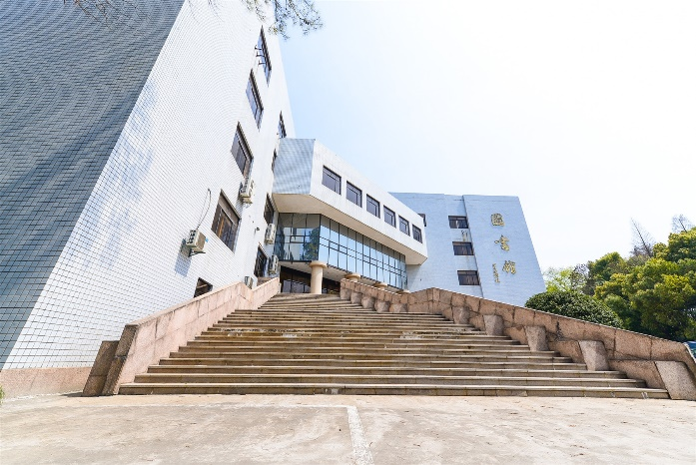
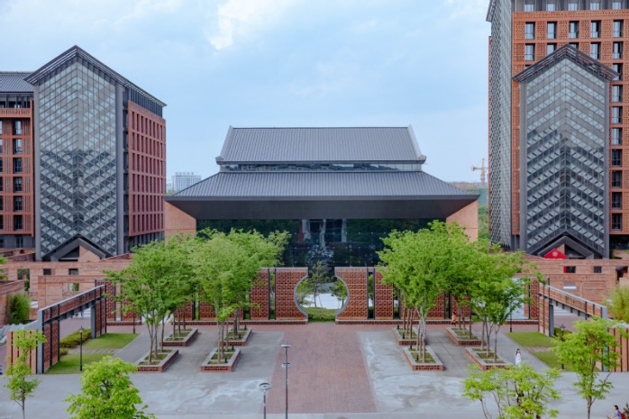

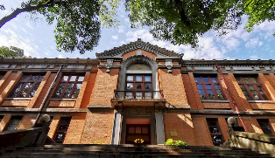
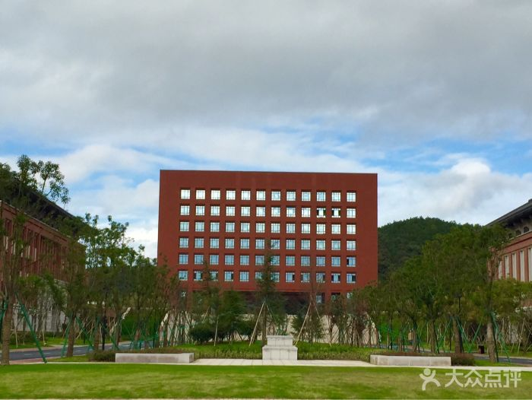
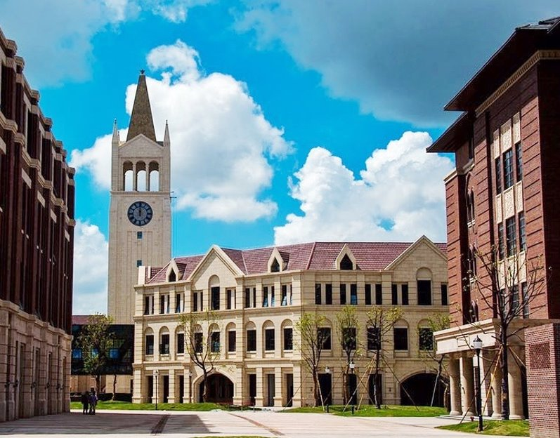

1
Zhejiang University Libraries
Yuquan
Science & Engineering​
Xixi
History & Philosophy​
Huajiachi​
Biology, Medicine​
Zijingang​
All disciplines​
Zhijiang​
Law ​
Zhoushan
Onceanology​
Intl Campus​
the disciplines in our campus​
Notes:
Zijingang Main Library​ All disciplines \ Zijingang Basic Library​ All disciplines \ Zijingang antiquarian ​Ancient Chinese Books \ Zijingang Agricultural
Medical Library Medicine, Pharmacy, Life Science​ ​

Slide 3


2
International Campus Library
Open Day​
Sep. 18th, 2017
ZJU Libraries Collection
7,039,000+​​
ZJU Libraries E-resource
Database: 862
E-book: 2,732,000​
E-journal: 13,490,000​
Library Seat​
600​
Library
Library Collection​
300,000 109,800+​
Open Hour​
8:30-22:30 Mon-Sun​
Notes:
For students of ZJE or ZJUI, you can not only get resources from Zhejiang University Libraries, you can also access to resources in UoE and UIUC libraries.

Slide 4
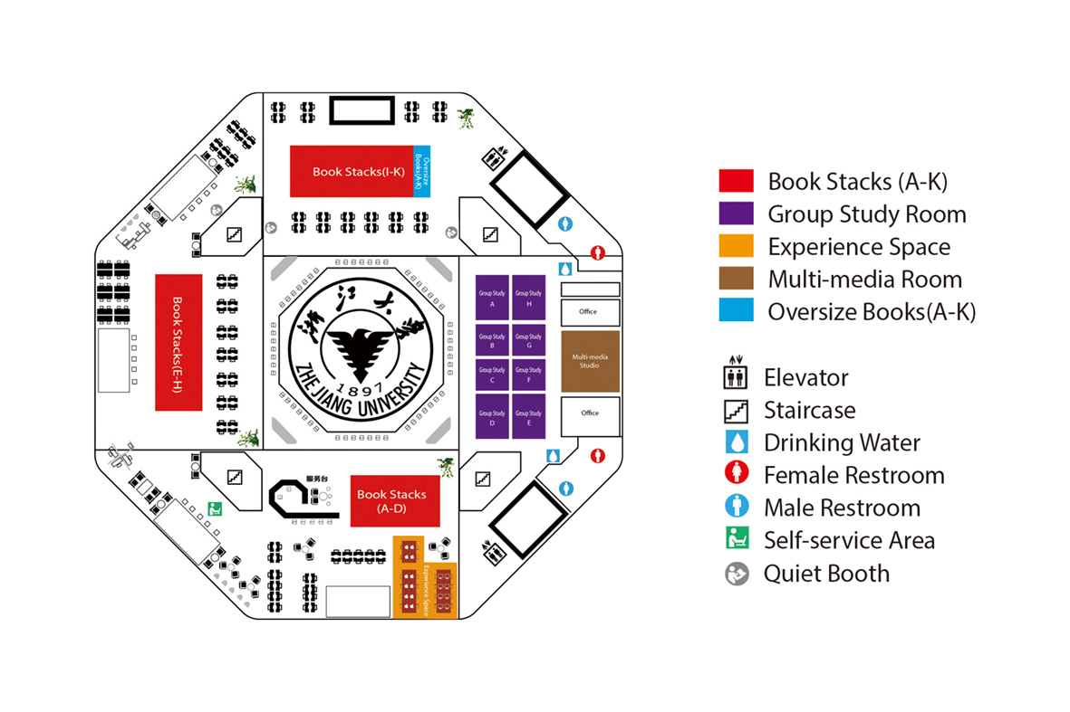
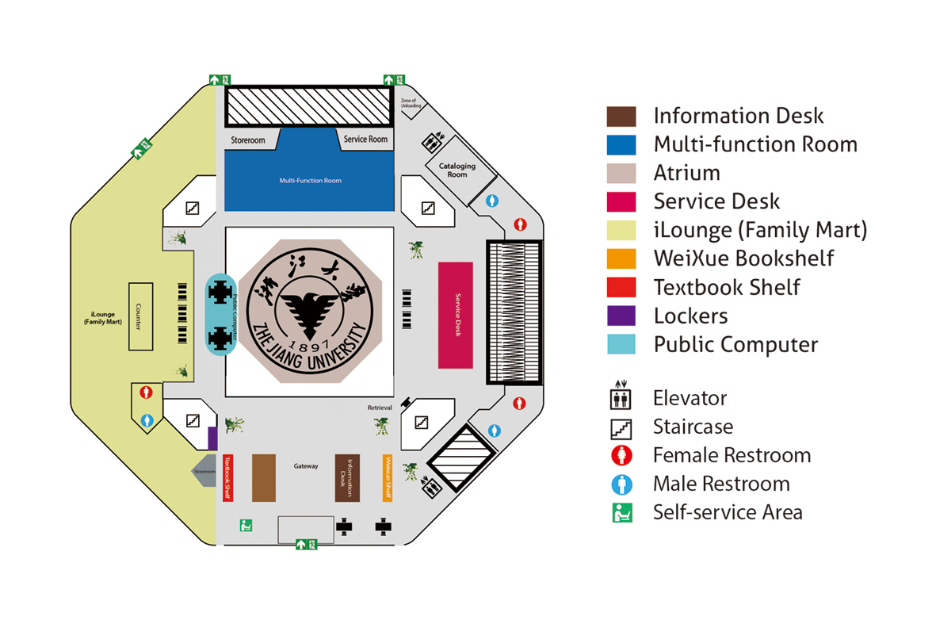
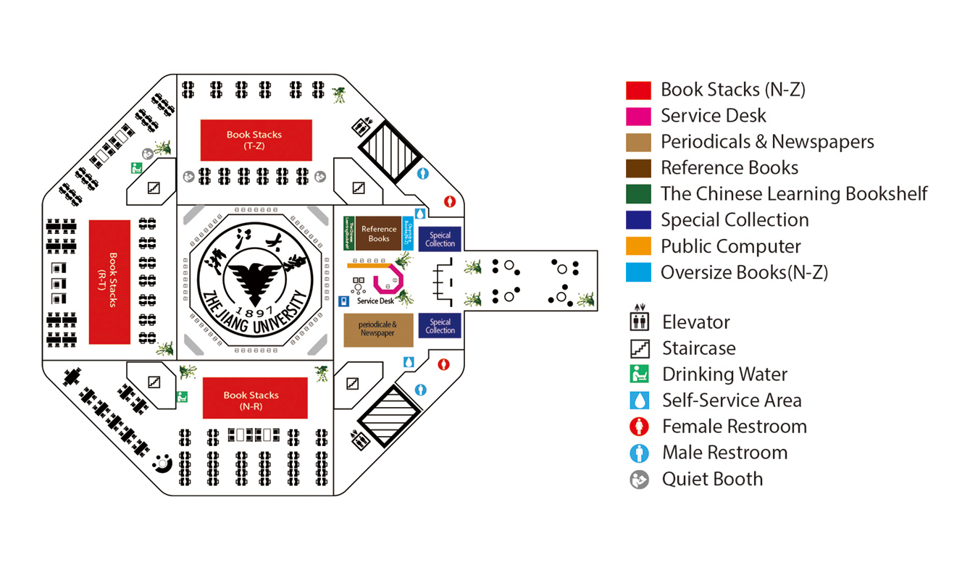
3
Floorplan
1F
3F
2F

Slide 5
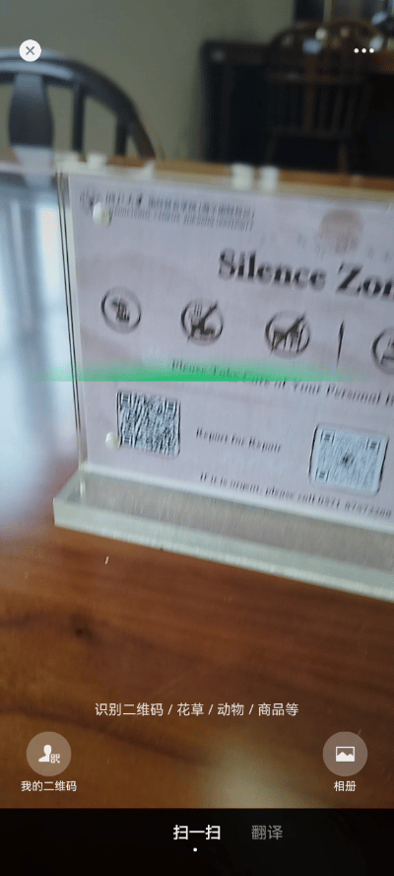
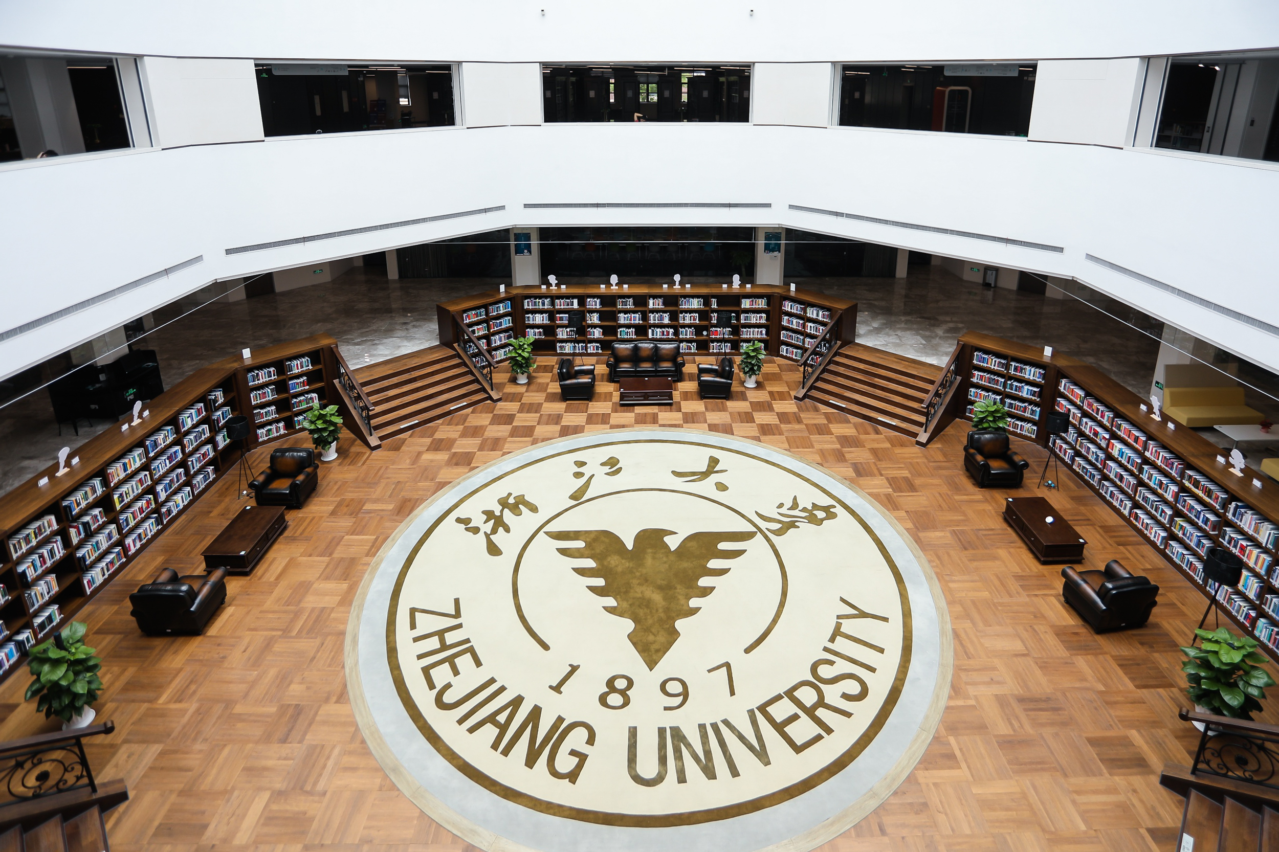

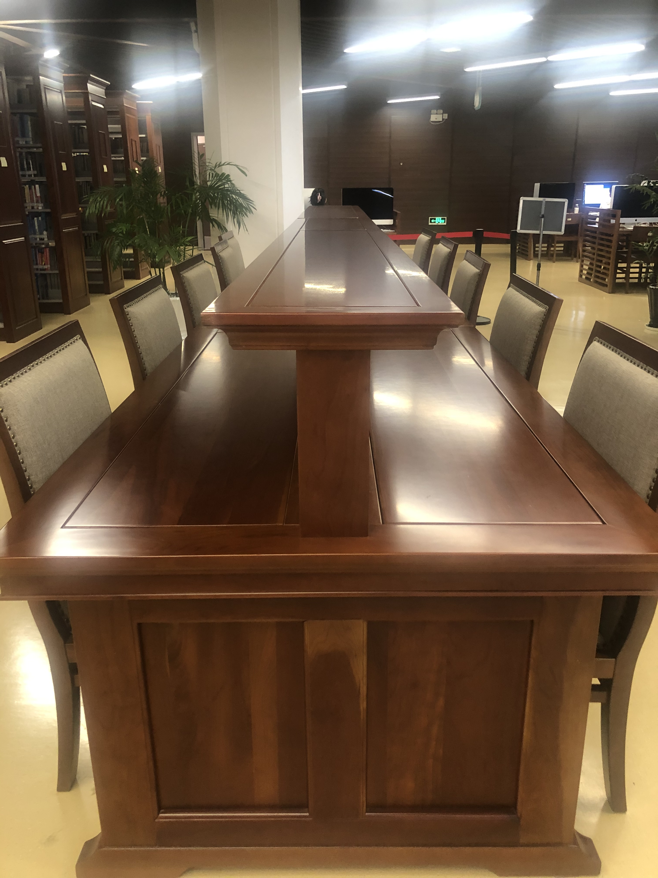
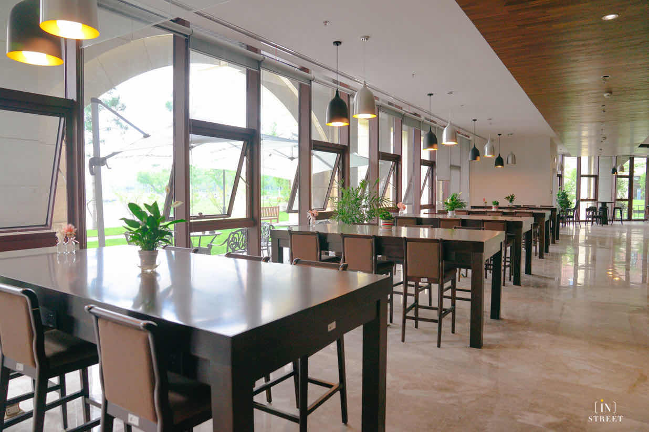
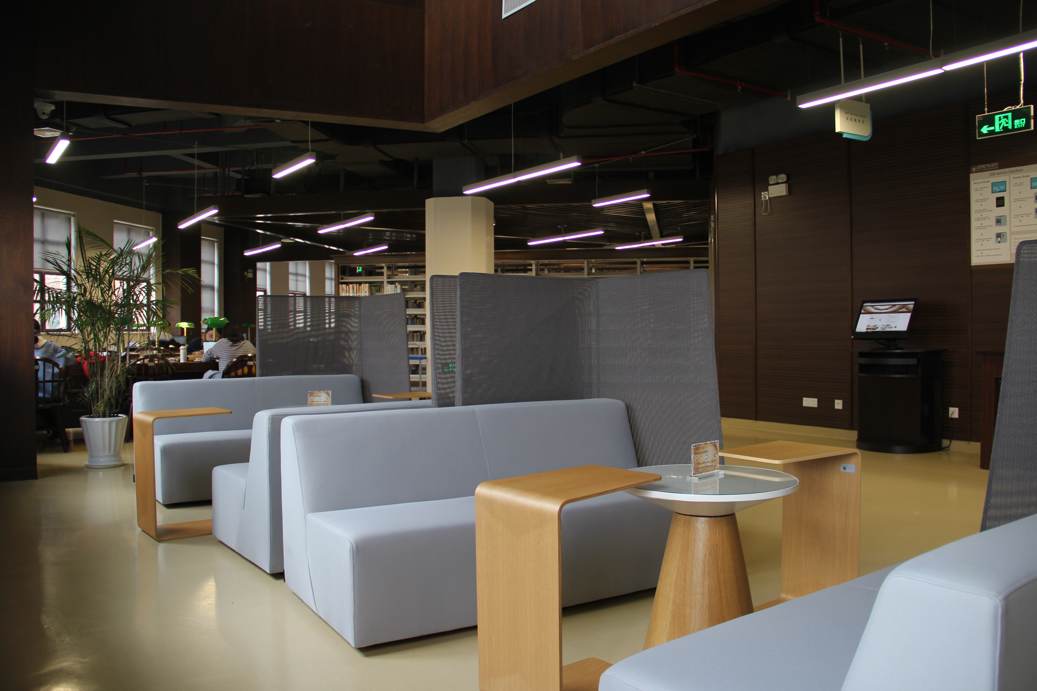
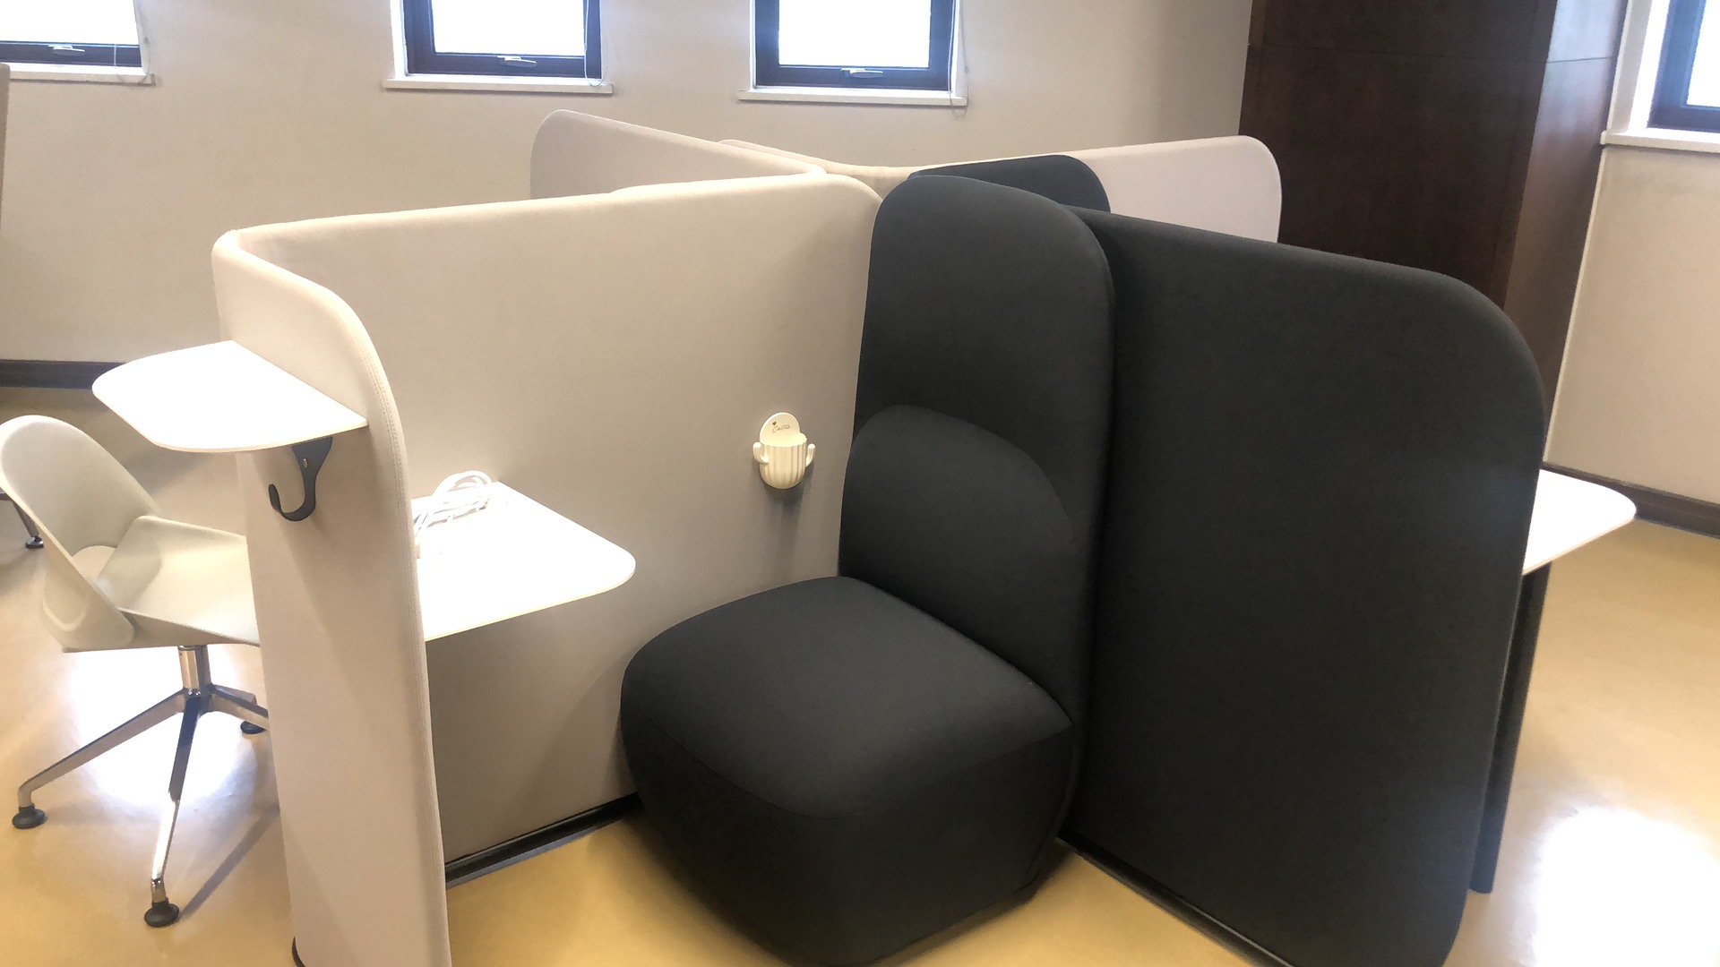
3
Floorplan
First Floor
Second Floor
Third Floor
Report for Repair
码上修

Slide 6

4
Resource Access
Paper Books
Dissertation
Conference Articles
Handbook
Journals
Textbook
E-books
E-journals
Journal Articles
……
Resource Categories​​
English / Chinese
Paper / E-resources
Comprehensive / Subject-related ​​
​​

Slide 7
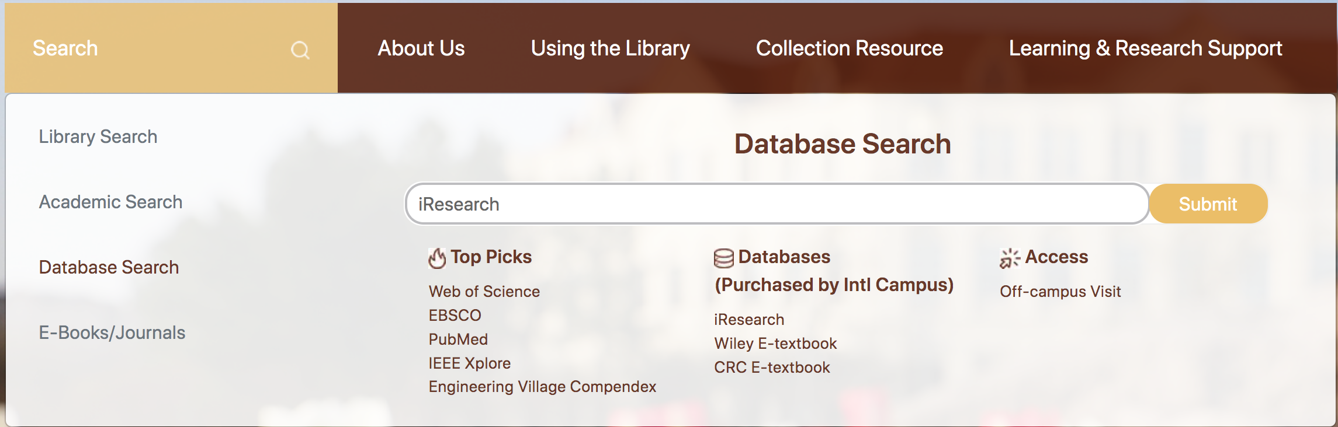
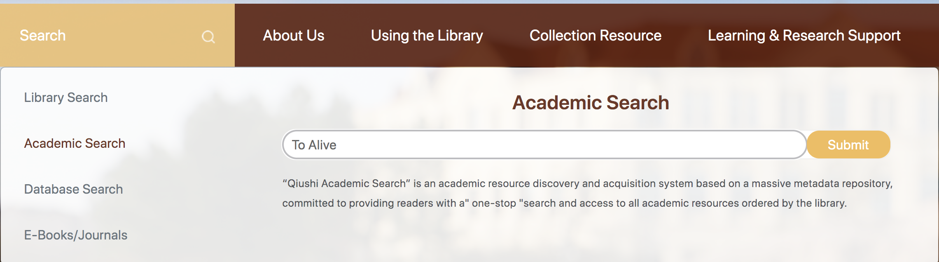
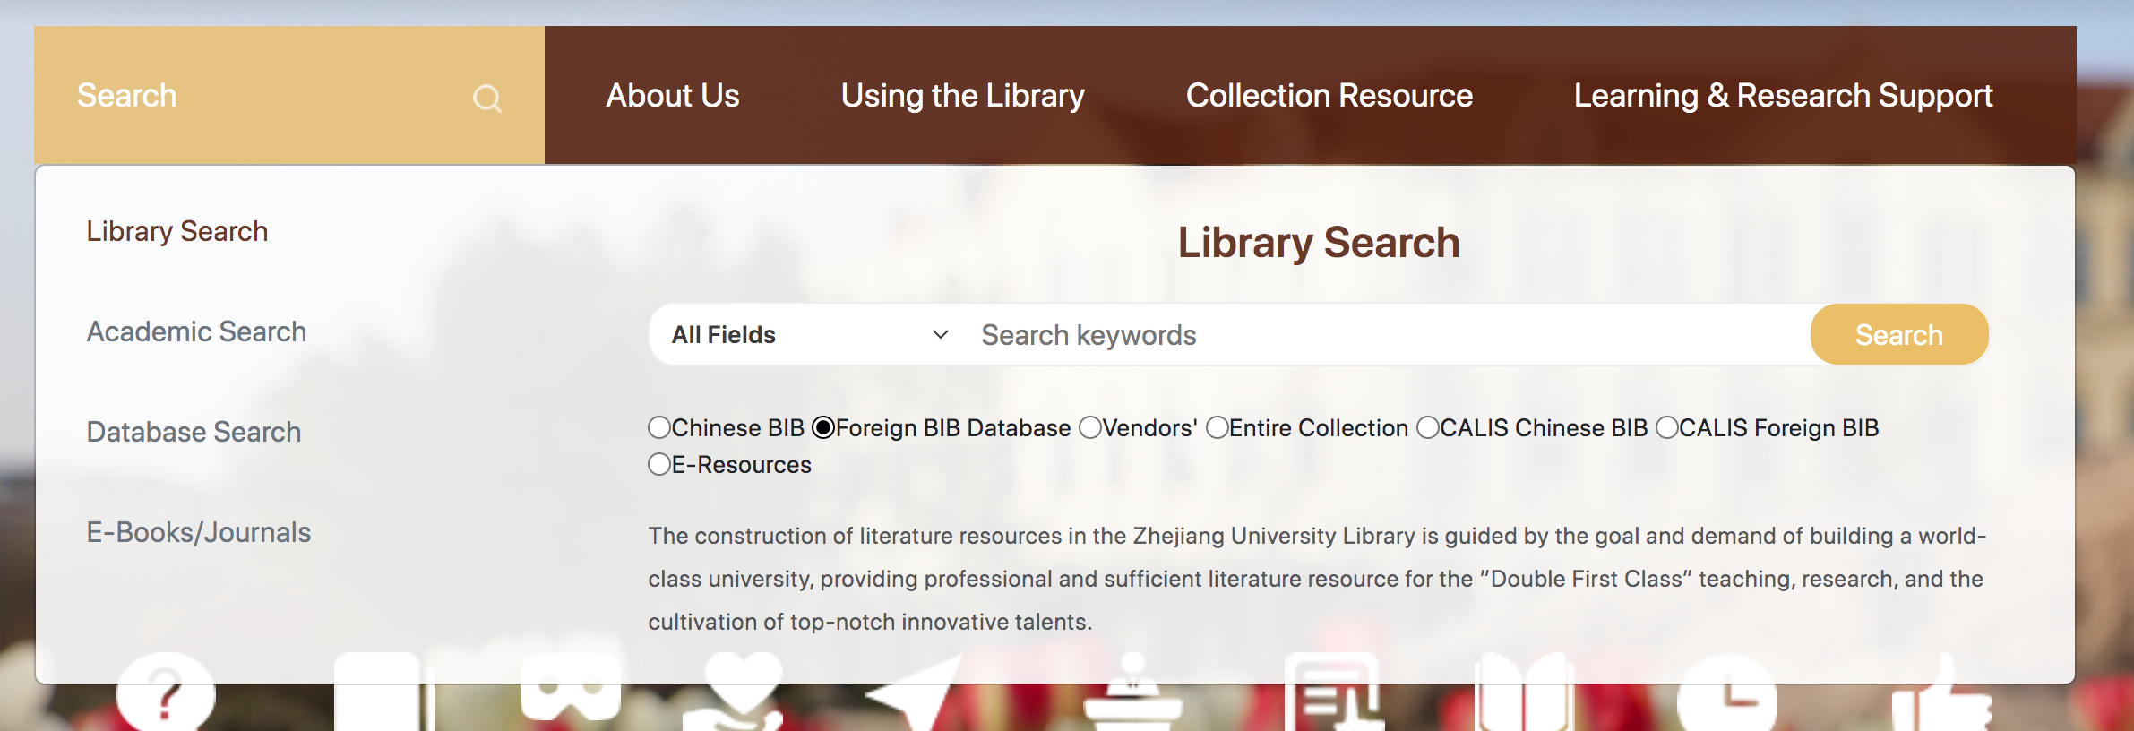
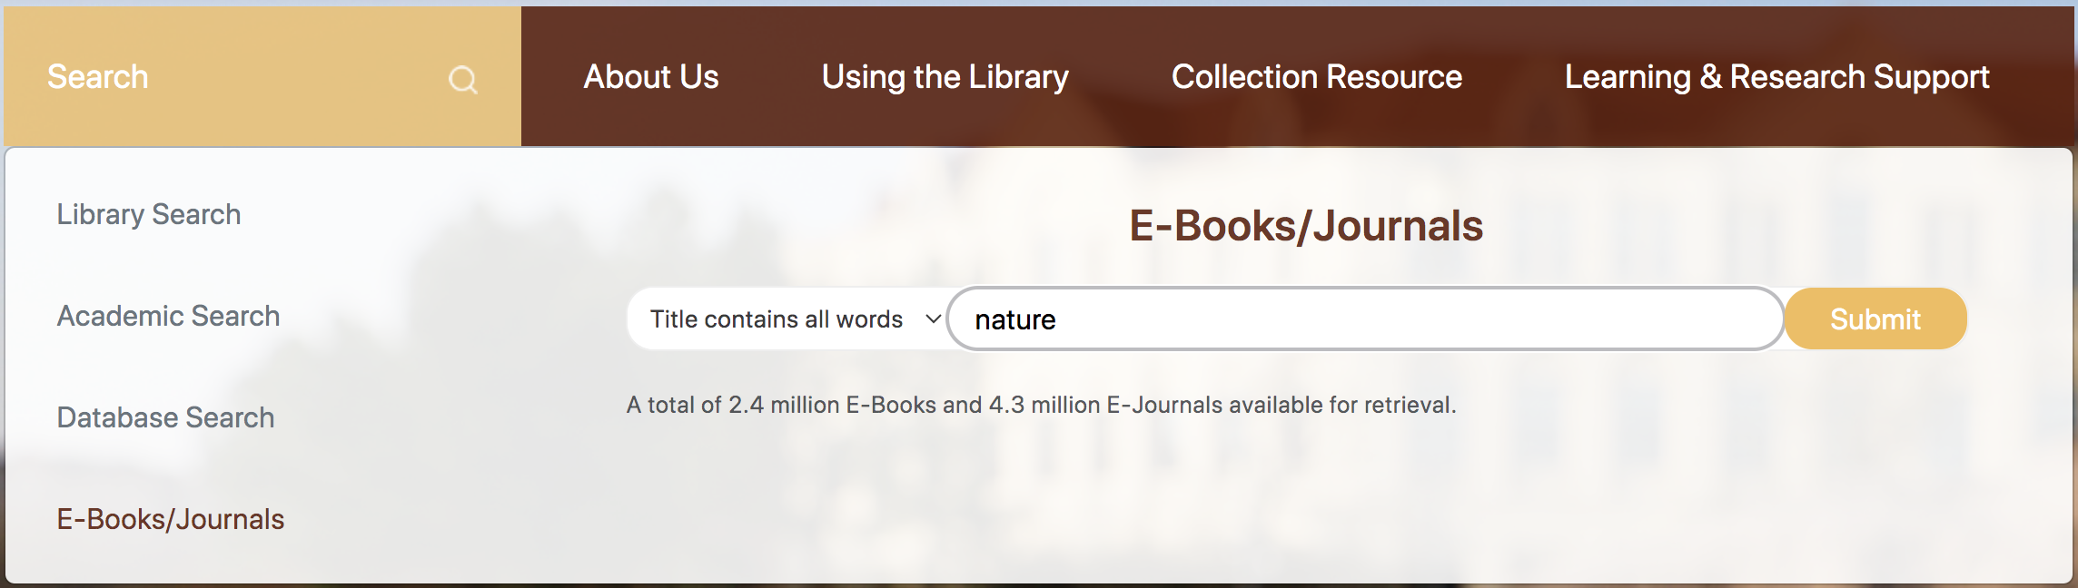
4
Resource Access
Paper books, journals, textbooks
To know a new subject
Journals articles, e-books, dissertations, conference articles
Library
Search
Database
How to
Access?
E-journals, E-books
eg: Nature、Science，Cell
To know search frontiers
E-
Journals
E-books
One-stop search
To search all the resources categories
Academic
Search
Academic
Search
​​
  (Open http://lib.intl.zju.edu.cn）​

Slide 8

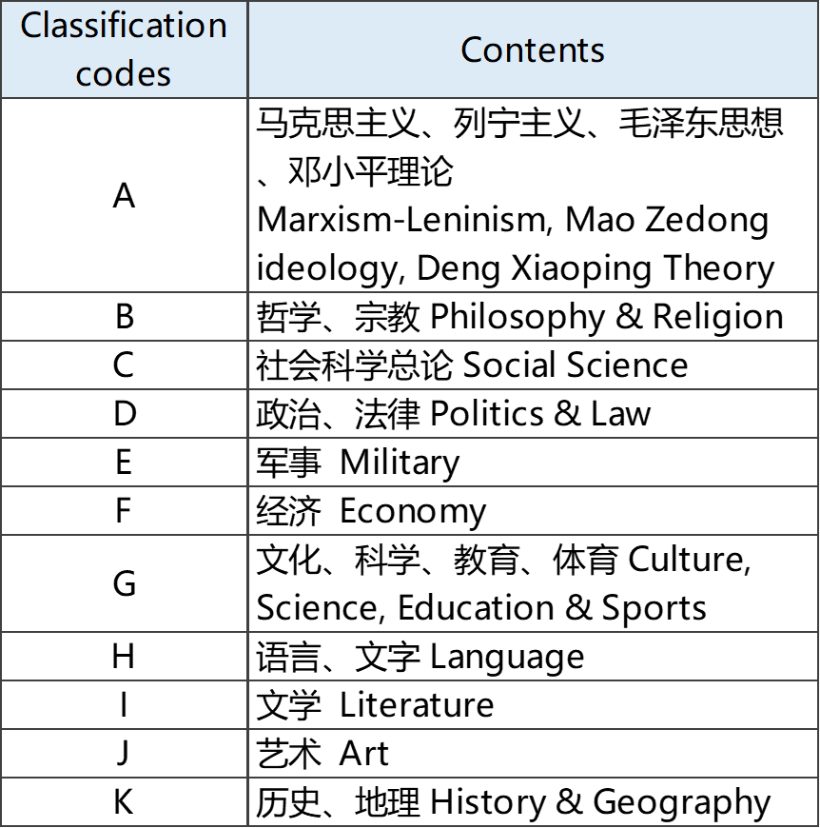
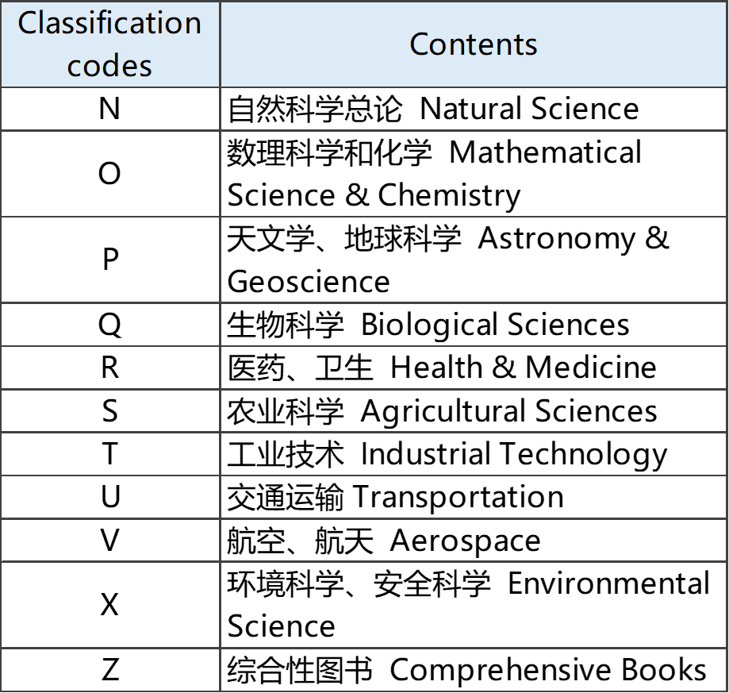
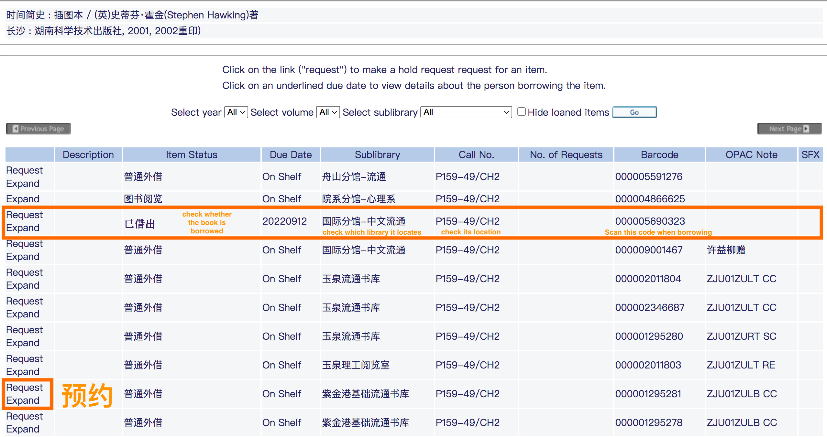
4.1
  1. Borrow Books
Book Access
  1. Borrow books
  Activate your Library Account
  100 books，40 days, ​Renew unlimited times
  Call Number
  2. Reserve Books
  3. Search for e-books
  in database or
  e-journals/e-books
  ……
  A Short History of Nearly Everything
  Bill Bryson
  2. Reserve books
  Borrowed / In other branches
  30 Books
  Pick-up at Information Desk
  N49
  LB3

Slide 9
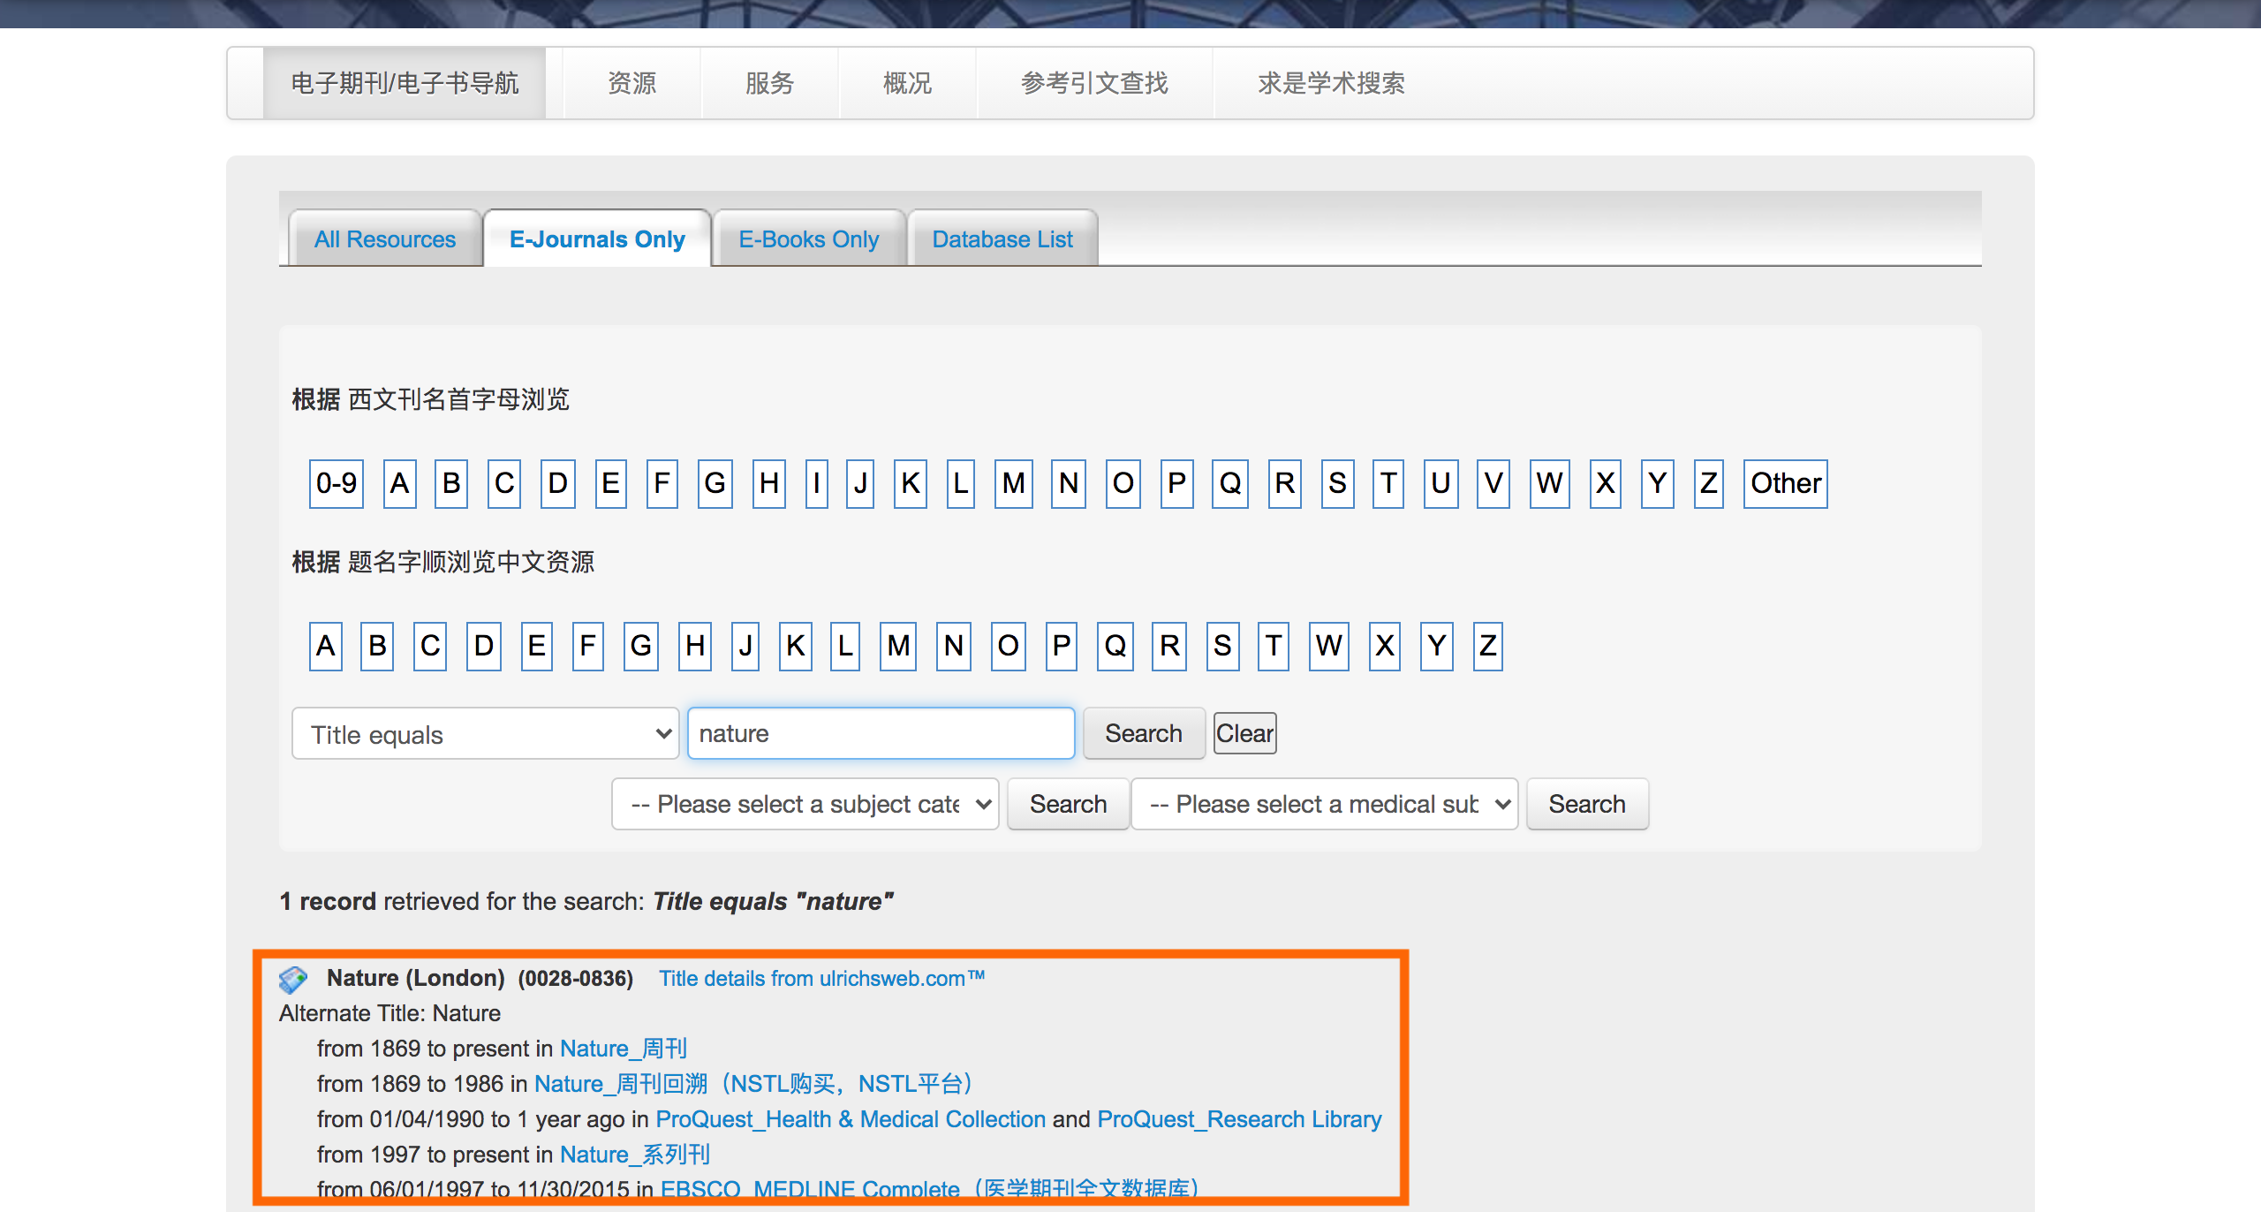
4.2
Journals Access
1. Periodical & Magazine Bookshelf
Categories: 21
High-affect-factor international Magazines Eg: Nature, Science, Economist
Location: Second Floor
Rule: For Reading Only
3. Search journal articles in database
2. Search
E-journals
on
library website
Database

Slide 10
4.3
Textbook Access
In Purchase
Type & Policy​
Public compulsory course-must buy​
Institute course-purchase willingly except the first term​
Teaching materials-purchase willingly
Order time:
Every May and October​
Textbook Bookshelf
Location: 1st Floor
Range: Almost all the textbooks
Search: Library Search
Short-time Loan
Notes:
(公共必修课教材）​
（学院课程教材）​
（教学辅助教材)​

Slide 11
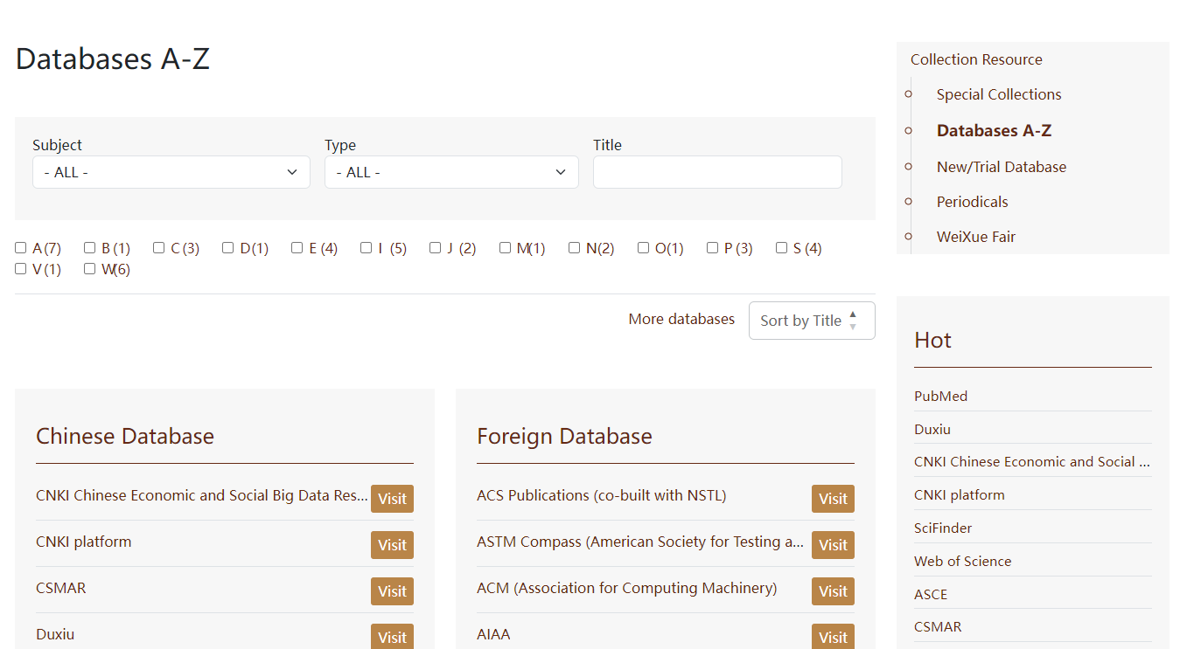
4.4
Database
Library website-Collection resources-Database(A-Z)
Common Database
Comprehensive
Web of Science​、EBSCO、知网（CNKI）、万方、维普​​​
Engineering
Engineering Village​、IEEE Xplore、ASCE、ASME​
Journal
Articles
Biomedicine
PubMed​、CBM
Business
Emerald
English
Chinese
超星
京东读书专业版
Elsevier ScienceDirect E-books
Comprehensive
EBSCO E-books
爱学术（iResearch）
E-books
ACM电子书 美国计算机协会电子书
Subject-related
ASCE 美国土木工程师学会数据库
ASME 美国机械工程师学会
Notes:
一、综合类：​
（一）中文：​
1、CNKI​
2、万方​
3、维普​
（二）外文：​
1、Web of science​
（1）学科：自然科学、社会科学、艺术与人文学科；（2）核心集：引文索引数据库：SCI\SSCI\AHCI,两个会议论文引文索引数据库: CPCI-S\CPCI-SSH; （3）亮点：收录论文中所引用的参考文献，并按照被引作者、出处和出版年代编成独特的引文索引。​
2、EBSCO​
（1）学科：自然科学、社会科学、人文和艺术 （2）亮点：两个主要全文数据库是：Academic Search Premier和Business Source Premier.​
Academic Source Premier （ASP）: 收录8千多种刊物的索引及摘要，4千多种全文期刊，Business Source Premier（BSP）：收录3千多种期刊索引及摘要，2千多种全文期刊​
​
二、专业相关​
1、工科​
（1）Engineering Village：① 学科：工程信息资源 ② 亮点：核心产品《Engineering Index》（Ei）闻名于世。​
（2）IEEE Xplore 隶属于IEEE-美国电气和电子工程师协会 ①学科：计算机科学、电机工程学、电子学等相关领域 ②文献类型：摘要、全文。③来源：基本覆盖了电气电子工程师学会（IEEE）和工程技术学会（IET）的文献资料，收录了超过2百万份文献。​
（3）美国土木工程师学会（The American Society of Civil Engineers，简称ASCE）① 全球最大的土木工程信息知识的出版机构 ② 文献类型：专业期刊和会议录，总计超过73,000篇全文、650,000页资料；每年新增约4,000篇文献。③ 录注重实际应用，为土木工程从业者和研究者提供对新兴技术和前沿技术发现的全面而深入的研究信息。​
(4）美国机械工程师协会American Society of Mechanical Engineers（ASME） ① 500多个工业和制造业标准​
2、人文社科​
（1）Emerald​
①科学：管理学②文献类型：全文期刊库、学习案例集（Case Study Collection）​
​
​
asme - american society of mechanical engineers 美国机械工程师学会​

Slide 12

4.4
LibGuides
How to access?
- https://lib.intl.zju.edu.cn ​
- Research Support
LibGuides
Choose your subject
Subject Information
Course Information
Information Literacy​
Notes:
Subject Information​
Paper Resources​
Databases​
E-Journals & Books​
Academic Frontier​
Academic Lectures​
Multimedia Resources​
Course Information​
Textbooks & References​
Online Courses​
……​
Information Literacy​
Information Literacy Training Guide​
Citation & Writing Tools Guides​
……​

Slide 13







4.5
E-resource Off Campus Access
VPN
Visit rvpn.zju.edu.cn​
Download and install the EasyConnect platform​
Input server address and log in with INTL ID
In campus: in ZJU IP
Off campus: Three ways
Get instructions in Library website
Three Ways for off campus Access
Remote Access
IEEE Xplore​
Elsevier ​ScienceDirect​
ACS
CARSI
50+ Eg：EBSCO；Elsevier；IEEE；ProQuest；Springer Nature；CNKI；

Slide 14






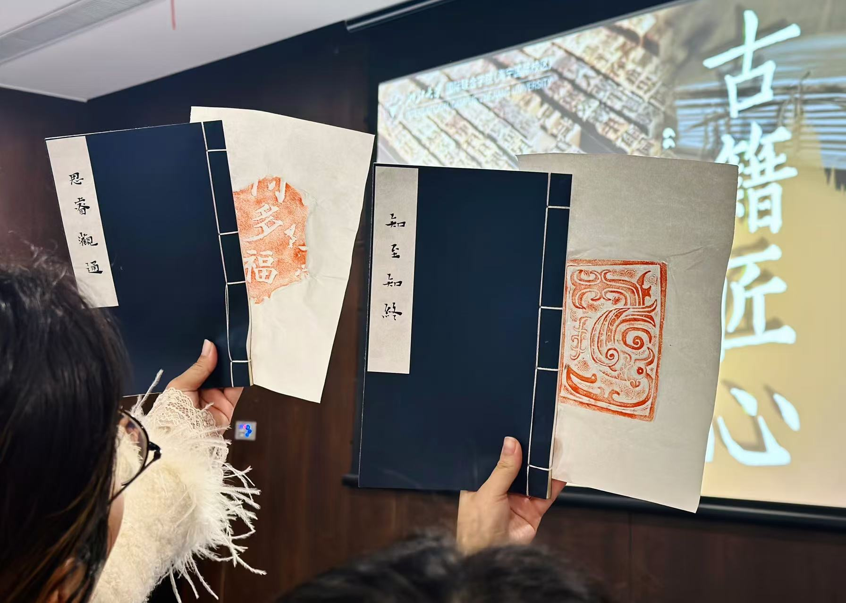
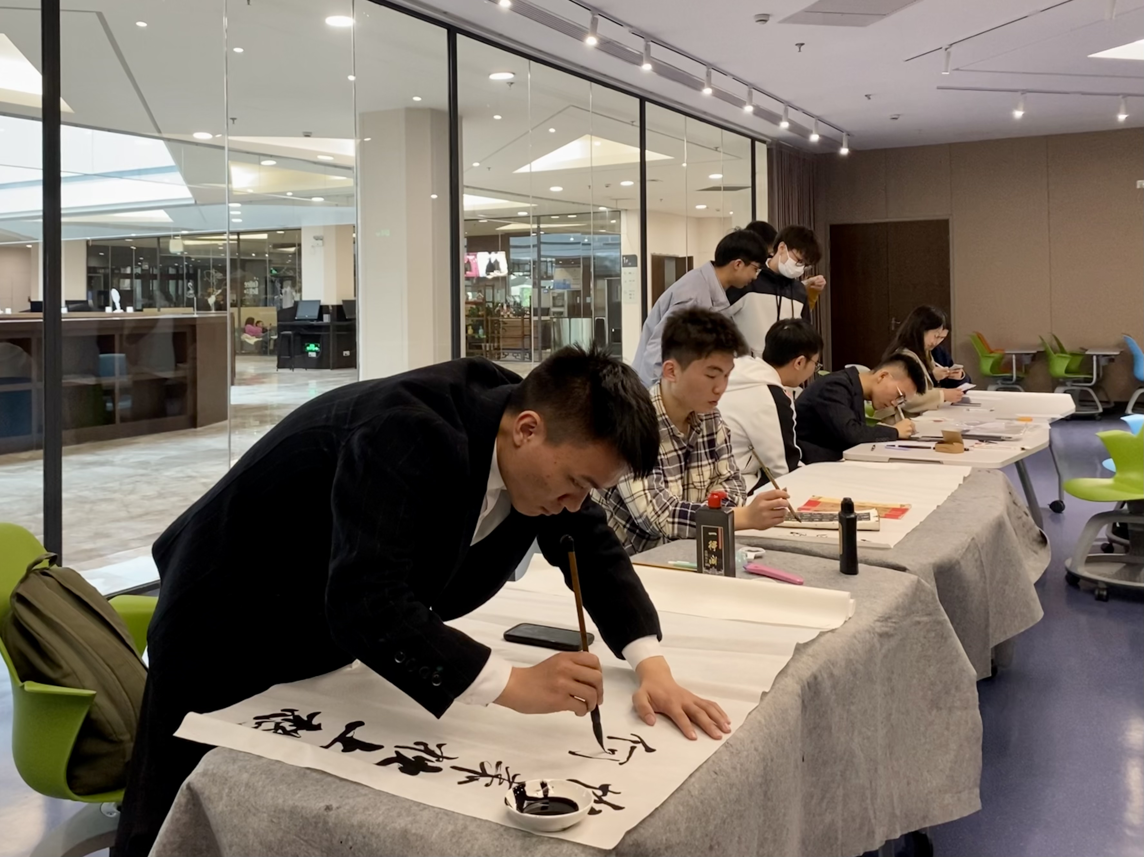










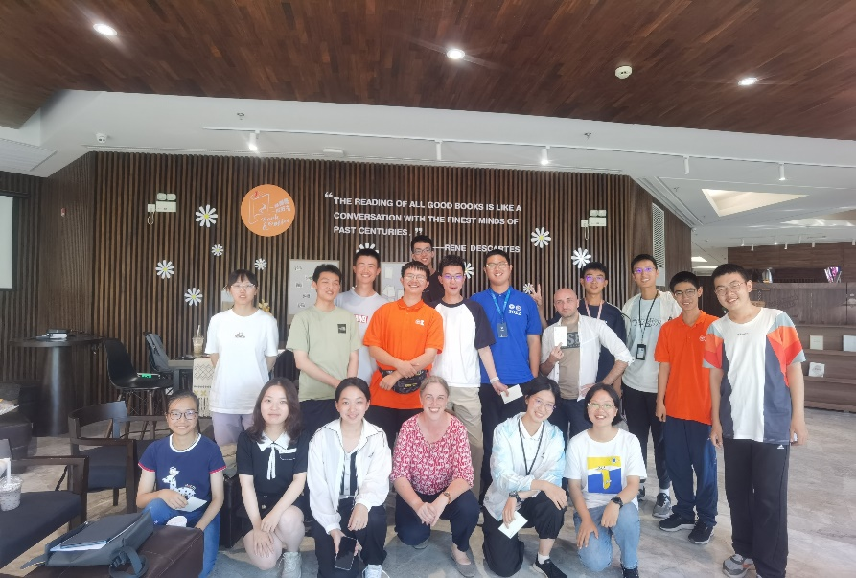
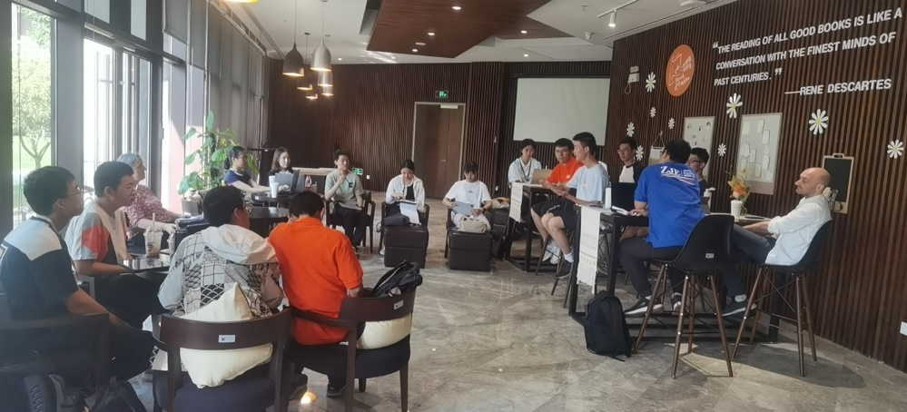

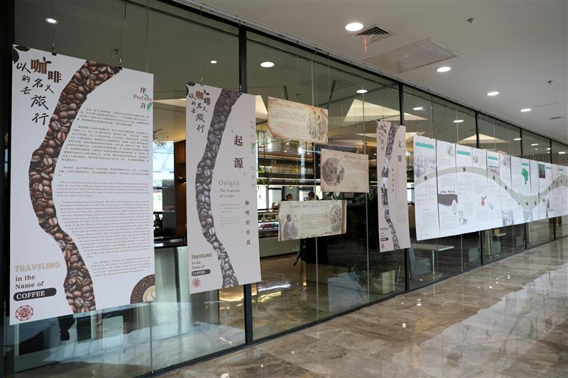
4
Lectures & Activities
Information Literacy Training
01
Cultural Activity
02
“ Weixue”
Every Friday
Resource Access & Tools
Schedule each semester
Reading Activities
03
Reading Corner
One Book Project
Book & Coffee

Slide 15
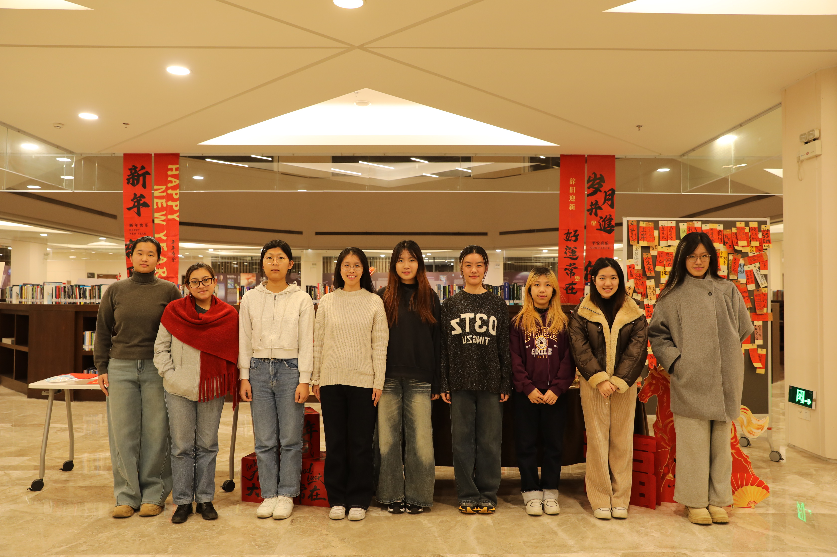

5
Student Assistant
· Work content
Library service, new media operation, IT engineering, translation …..
Welcome to join us!
Tel：
0571-87572288
Mail：library@intl.zju.edu.cn
iLINK浙大国际校区图书信息服务
Notes:
放在结尾

Slide 16
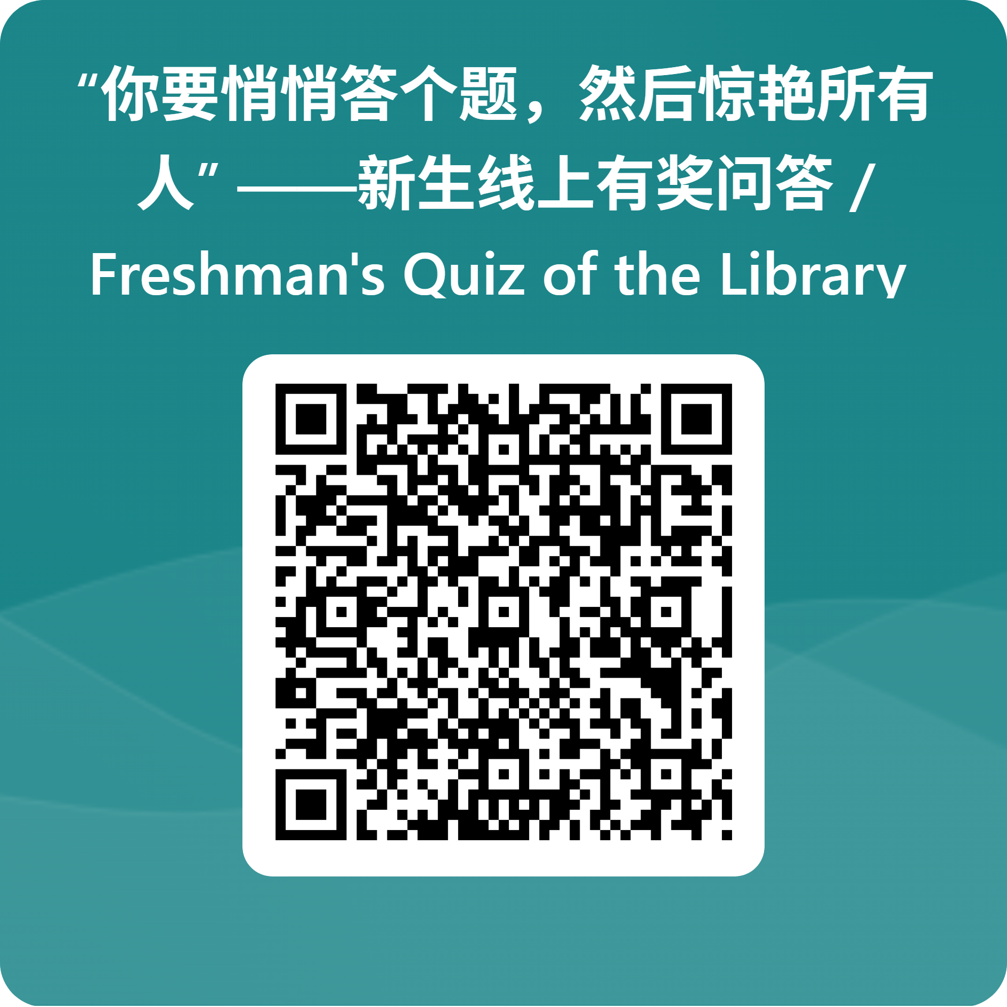
6
Quiz
Scan QR Code for Participation
Results Out: 2026.9.15
Prize: anyone who get 100 score can obtain a prize in the library Information Desk.
First Come, First Serve.
Notes:
放在结尾

